Slide 1
Quality function deployment (QFD)
is a method developed in Japan beginning in 1966 to help transform the voice of the customer in to engineering characteristics for a product
Yoji Akao, the original developer, described QFD as a "method to transform qualitative user demands into quantitative parameters, to deploy the functions forming quality, and to deploy methods for achieving the design quality into subsystems and component parts, and ultimately to specific elements of the manufacturing process.

Slide 2
Quality function deployment (QFD)
Mizuno and Furukawa used Akao’s theory to improve production at Mitsubishi’s Kobe Shipyard. As more companies adopted these procedures, Akao’s ideas evolved to form QFD, a methodology that converts user requirements into quality characteristics, and predetermined the quality of the finished product, its individual parts and production processes.
Toyota adopted QFD and reported a 61% reduction in start up costs from in 1984, in comparison to 1977.
After gaining popularity in Japan, Clausing and Hauser published The House of Quality in the May-June 1988 Harvard Business Review. QFD gained much attention because of this and was adopted by companies such as Ford, General Motors and IBM.
Notes:
CHAN, L.-K. & WU, M.-L. 2002a. Quality function deployment: a comprehensive review of its concepts and methods. Quality Engineering, 15, 23-35.
CHAN, L.-K. & WU, M.-L. 2002b.

Slide 3
QFD
Quality function deployment (QFD) is ‘‘an overall concept that provides a means of translating customer requirements into the appropriate technical requirements for each stage of product development and production (i.e., marketing strategies, planning, product design and engineering, prototype evaluation, production process development, production, sales)’’ (Sullivan, 1986b).

Slide 4
Four Phase Model
The most common form of QFD is known as the Four Phase Model (Chan and Wu, 2002a).
Each phase uses a similar matrix to determine the relationship between pairs of parameters that Chan (2002a) calls WHATs and HOWs.
Five sets of parameters are used: customer requirements, technical measures, parts characteristics, process operations, production requirements.
Each of the four consecutive pairs is analyzed as a WHAT vs HOW

Slide 5
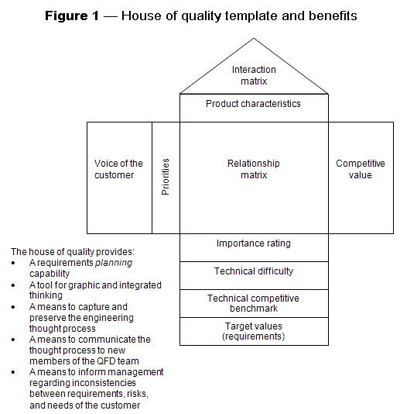
Notes:
QFD

Slide 6
Customer requirements were defined and rated from 1-10 and from this their relative importance was calculated.
Technical measures were listed, including units and direction of improvement. The relationship between these was analyzed in the ‘roof’ section. (++ ; strong positive,+ ; weak positive,(none) ; no correlation, - ; weak negative, -- ; strong negative)

Slide 7
The planning matrix was used to determine the final importance of customer requirements.
First, competitor products were rated (1-5) by their ability to meet customer requirements.
Products fulfilling the scope of the project could not be identified so comparable technologies were critiqued instead.
Target ratings (1-5) for the project were made based on competitor ratings and customer requirement importance.
Sales points - an indication of how meeting a customer requirement target would increase the attractiveness of the system to potential buyers - were determined (1.00: weak, 1.25: moderate, 1.5: strong)

Slide 8
4. Interrelationships between each customer requirement and each technical measure were assigned a value (9: strong, 3: moderate, 1: weak, 0: none).
5. The Technical Matrix was used to examine the technical measures. A target value for each technical measure and the degree of difficulty (1-10) in achieving this value were determined.
.

Slide 9
HOUSE OF QUALITY - QFD
The house of quality, a part of QFD, is the basic design tool of quality function deployment.
It identifies and classifies customer desires (What's), identifies the importance of those desires, identifies engineering characteristics which may be relevant to those desires (How's), correlates the two, allows for verification of those correlations, and then assigns objectives and priorities for the system requirements.
This process can be applied at any system composition level (e.g. system, subsystem, or component) in the design of a product, and can allow for assessment of different abstractions of a system.
It is intensely progressed through a number of hierarchical levels of What’s and How’s and analyse each stage of product growth (service enhancement), and production (service delivery).

Slide 11
The output of the house of quality is generally a matrix with customer desires on one dimension and correlated nonfunctional requirements on the other dimension.
The cells of matrix table are filled with the weights assigned to the stakeholder characteristics where those characteristics are affected by the system parameters across the top of the matrix.
At the bottom of the matrix, the column is summed, which allows for the system characteristics to be weighted according to the stakeholder characteristics.
System parameters not correlated to stakeholder characteristics may be unnecessary to the system design and are identified by empty matrix columns, while stakeholder characteristics (identified by empty rows) not correlated to system parameters indicate "characteristics not addressed by the design parameters".
System parameters and stakeholder characteristics with weak correlations potentially indicate missing information, while matrices with "too many correlations" indicate that the stakeholder needs may need to be refined.

Slide 12
Applications
QFD is applied in a wide variety of applications viz product design , manufacturing, production, engineering, research and development (R&D), information technology (IT), support, testing, regulatory, and other phases in hardware, software, service, and system organizations. organization functions necessary to assure customer satisfaction, including business planning, packaging and logistics, procurement, marketing, sales & service. QFD is also deployed in quality improvement, quality management, military needs and consumer products. Customer services Applications for Education improvement [and services in hotels etc.

